Slide 1
Understanding Earthquakes with GIS
William Mackaness, Carol Blackwood, Charlotte Graves
Institute of Geography
School of GeoSciences
University of Edinburgh
Drummond St, Edinburgh EH8 9XP
william.mackaness@ed.ac.uk
Notes:
-please switch off mobiles
The composition of the room (the two different classes)
Assessment
The practicals
systems and science, computer based problem solving, the development of GI science, its impact on the geographic discipline.
- the essential 5+1 parts,
-an education agenda
-course overview, learning outcomes, administrative issues.

Slide 2
Earthquakes
Measure on a Richter scale 1-7
  < 3 imperceptible
  7 + Considerable damage – depth dependent
Epicentre – offshore → tsunami
Located along system of geological faults
Longest fault lines:
  Turkey, Alaska, California (San Andreas Fault)

Slide 3
Earthquakes
Cluster in space & time
  Sometimes as ‘swarms’
90% earthquakes occur along Pacific Rim
  Pacific Rim of fire
Huge impacts on civilisation
  Port au Prince Haiti January 2010
  Japan March 2011

Slide 4
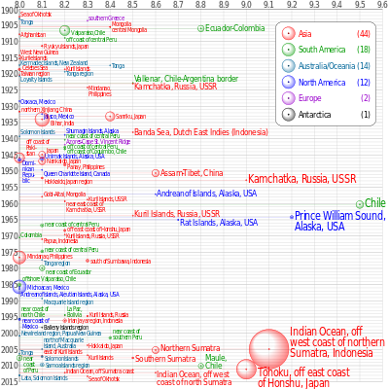

Slide 5
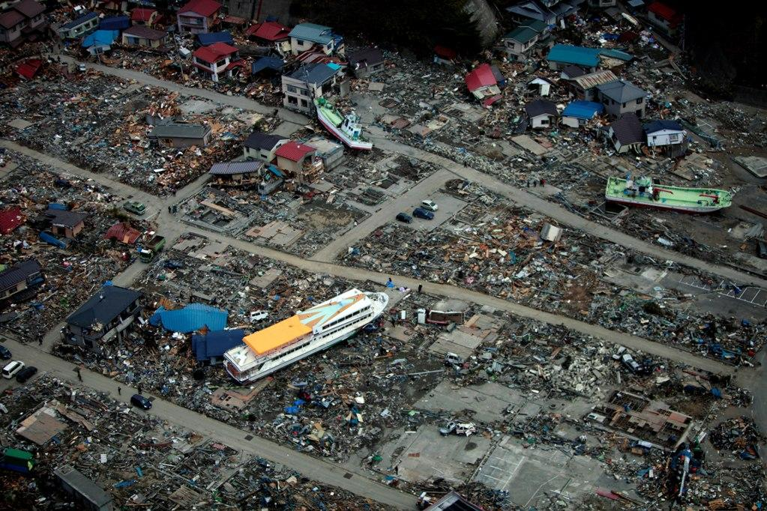
Notes:
Japan March 2011 Mag 9.00- Tsunami

Slide 6
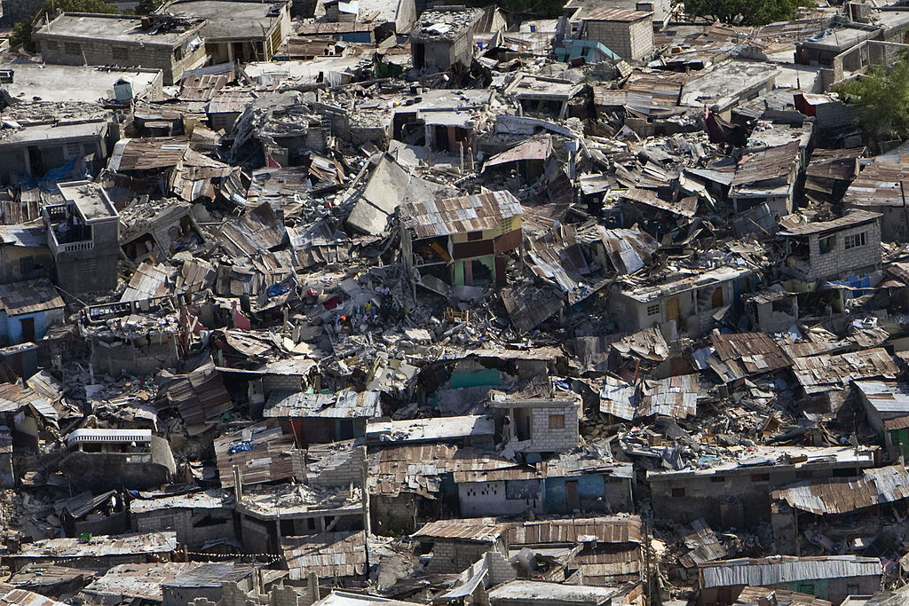
Notes:
Haiti Jan 2010
Long way from recovery – politically chaotic / corrupt before the event

Slide 7
Tutorial 4
Adding vector data
Changing Coordinate Reference Systems
Selection of graduated symbols
Buffering & Clipping
Using spatial query

Slide 8
Projection - important?
Creating spatial data (GPS data)
Import, combine, overlay with other layers
Display
TWO types of coordinate systems:
  Geographic Coordinate Systems
  Projected Coordinate Systems

Slide 9
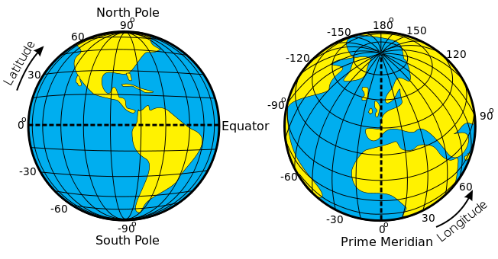
Notes:
A reference system using latitude and longitude to define the location of points on the surface of a sphere or spheroid
degrees/minutes/seconds (DMS) 92° 30’ 00” W

Slide 10
Datums
Datum defines the position of the spheroid relative to the center of the earth
  Origin and orientation of latitude and longitude lines are determined by the datum
WGS 1984
  Most recently developed datum/ framework for measurements worldwide
  Earth centered, or geocentric, perspective
  This is the datum used by all GPS satellites
We can transform between different datums
Notes:
Ask if anyone knows what the ellipsoid represents? SHAPE OF THE EARTH
Is the spheroid and ellipsoid the same? YES

Slide 11
Projected Coordinate Systems
Systematic transformation of locations on the earth (latitude/longitude) to planar coordinates
The basis for this transformation is the geographic coordinate system (which references a datum)
Map projections are designed for specific purposes

Slide 12
Projections: compromise in minimising distortion
Shape
Area
Distance/Scale
Direction/Angle
Notes:
Shape
Conformal map projections preserve shape
Area
Equal area map projections preserve area
Distance/Scale
Equidistant map projections preserve distance
Direction/Angle
Azimuthal map projections preserve true direction
All maps have errors. Something has to be sacrificed when choosing a projection.
These are the major characteristics which can be affected.
Maps that preserve Area are called Equal Area projections.
What type of map projection do you think would be used on maps used by sailors? Azimuthal/Equidistant

Slide 13
Sinusoidal Projection
Notes:
Ask class what type of map characteristic is preserved in this projection.
EQUAL AREA - areas on map proportional to areas on earth.
Used frequently in Atlases to show sedimentary basins throughout the world.

Slide 14
Mercator Projection
Notes:
Ask class what characteristic is preserved in this projection. SHAPE
CONFORMAL
Distortion increases away from Equator and extreme in polar regions.
Conformal - angles and shapes preserved within any small area are preserved.

Slide 15
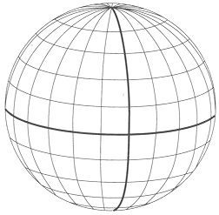
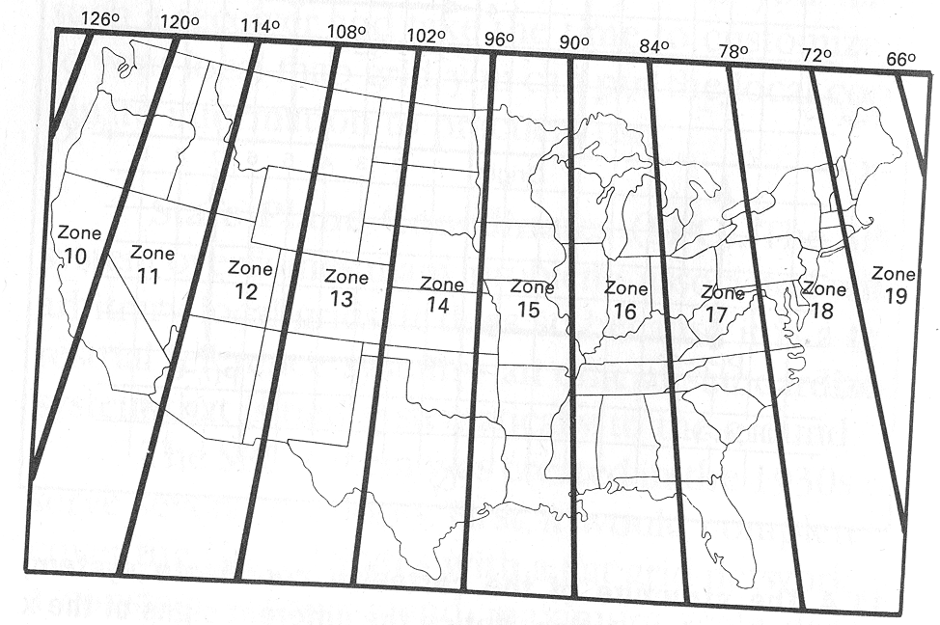
Universal Transverse Mercator (UTM)
Universal Transverse Mercator- Grid
Zone 1
Equator
International Date
Line - 180
o
Zone 18
Notes:
Developed by military
Grid system
Earth divided into 60 zones
Great for small areas
minimal map distortion
distortion greater at edge of zones
Most common map projection used by NWRs

