Slide 1
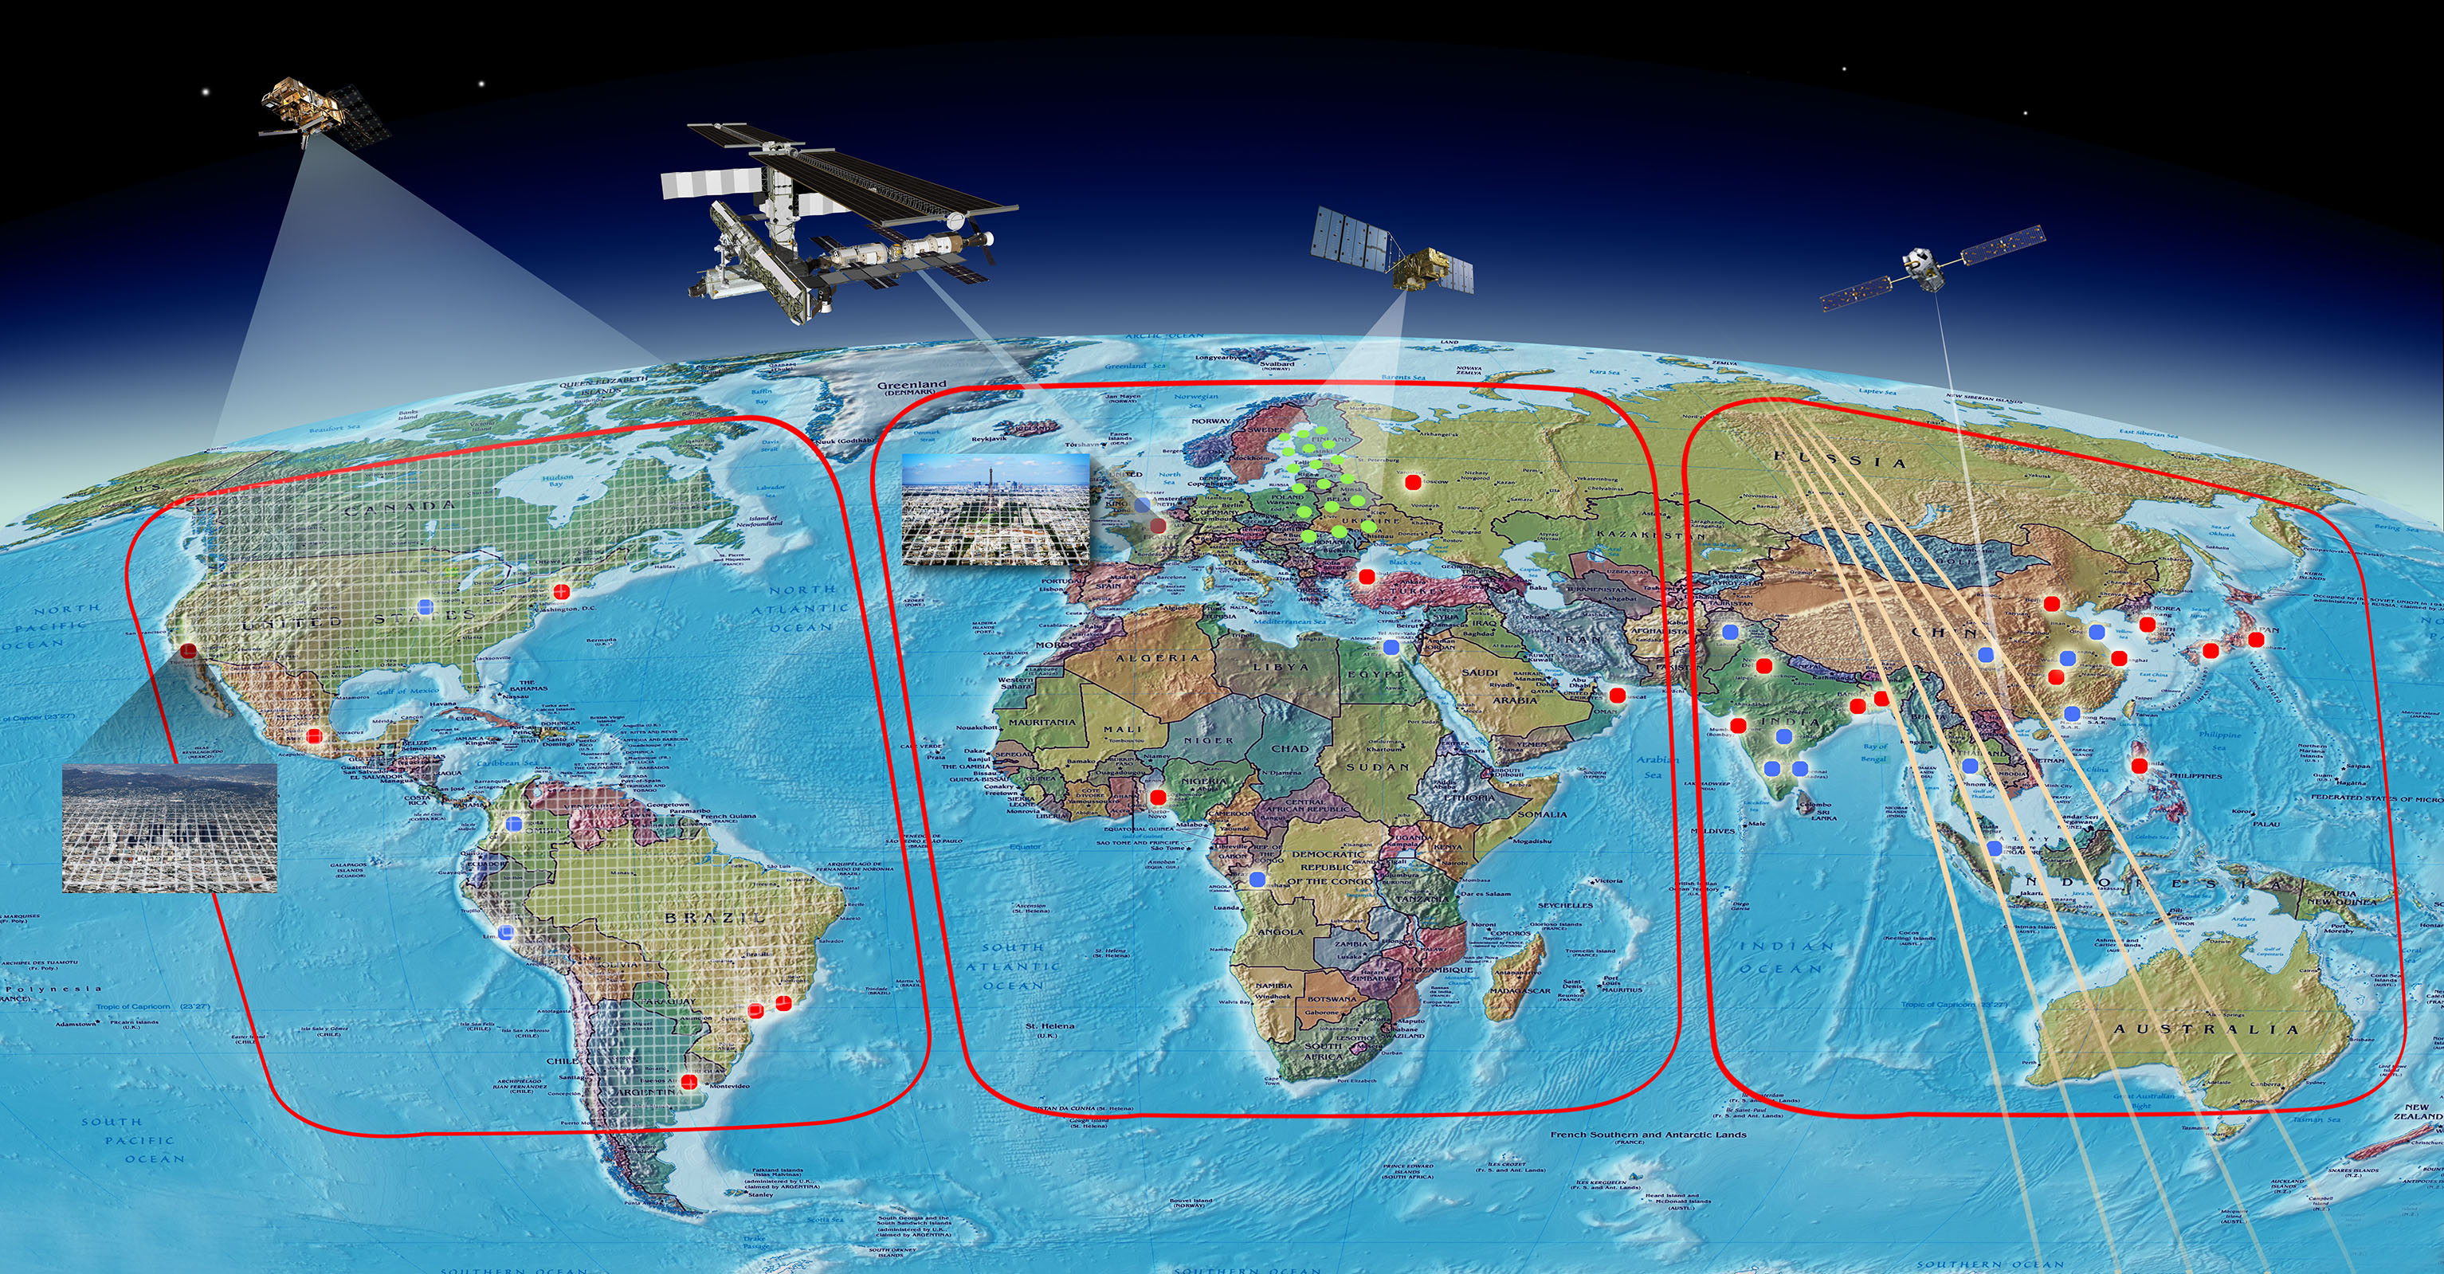
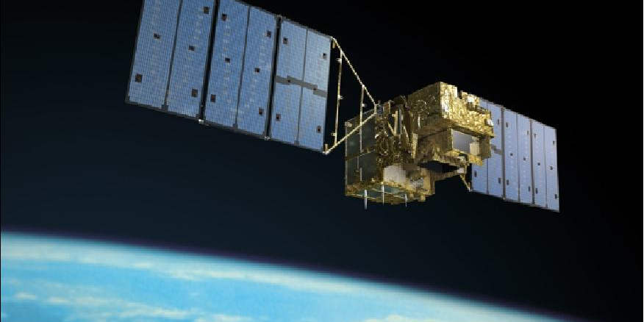
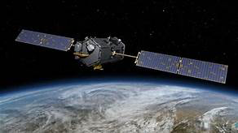
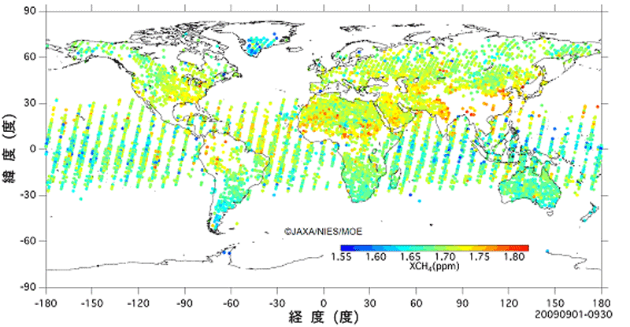
More and more space-based GHG observations available
From NASA Website
GOSAT 2009
GOSAT (2009); OCO-2 (2014); TanSat (2016); Sentinel-5P (2017); Fengyun-3 (2017); Gaofeng-5 (2018), GOSAT-2 (2018); OCO-3 (2019); MicroCarb (2020); GeoCarb (2022), TanSat-2 constellation (202X)……

Slide 2
Our main contributions:
1. Top-down estimates of regional GHG fluxes.
2 . Develop a framework for coupled land and atmospheric data assimilation

Slide 3
Top-down flux inversion
Liang Feng¹, Paul Palmer¹ ,
1: National Centre for Earth Observation, University of Edinburgh
Hartmut Boesch² Robert Parker², Peter Smokuti² ,
2:National Centre for Earth Observation, University of Leicester
Jing Wang², Yi Liu², Dongxu Yang²
3: Institute of Atmospheric Physics, CAS, China

Slide 4
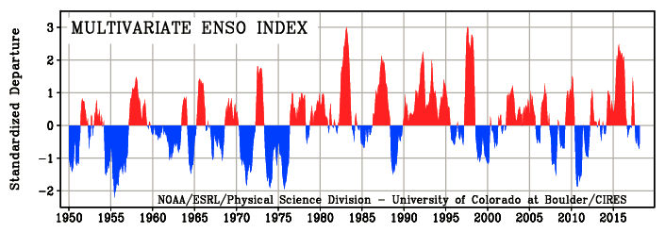
2014-2016 ENSO event
Onset from 2014 March to July
Peak from 2015 October to 2016 February
End in 2016 May
Notes:
Onset from 2014 3-7
Peak from 2015.10-2016.2
End in 2016 5

Slide 5
How can ENSO effect East Asian monsoon?
anomalous lower tropospheric anticycle
ENSO---------------------------Esat Asian monsoon
AAC: A large-scale anomalous anticycle
ACC: Anomalous cyclonic circulation
IOB: Indian Ocean Basin-wide
PJ:Pacific –Japan
EAP:East Asia-Pacific(EAP)
Ref: Xie.S et al., AAS,2016

Slide 6
Top-down Flux inversions
CTM:
Version: GEOS-Chem v9.02
Resolution : 4 (Lat) X 5 (Lon)/47 levels
Met Fields: GEOS-5 & GEOS-FP
Prior fluxes:
  ODIAC Fossil fuel emissions(2016).
  3-hourly biospheric fluxes (CASA till 2015.12 );
  Monthly oceanic surface fluxes (Takahashi)
  Weekly biomass burning emissions (GFED)
Time period:
2009.01 to 2016.12
Observations:
Insitu: In-situ observations (ObsPack: globalview v3.2)+ additional sites
OCO-2: Land nadir 10s XCO2 retrievals of v7 by JPL
ACOS-B7: GOSAT XCO2 retrievals by JPL (O’Dell el al.)
UOL-V7: GOSAT XCO2 retrievals by UoL (Parker et al.)

Slide 7
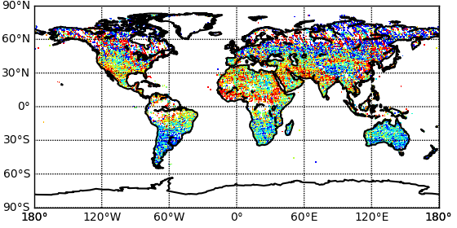
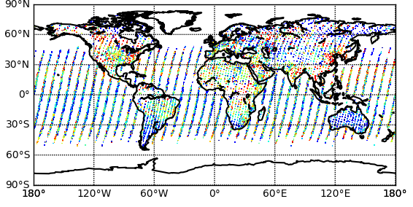

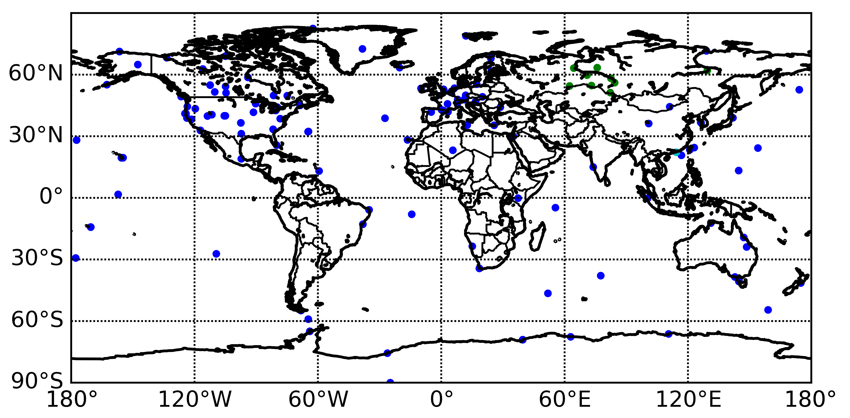

Observation coverage (satellite samplings in 2015)
OCO-2 v7 nadir
GOSAT UoL-V7
GOSAT ACOS B-7
In-situ sites
Obspack_co2_1_GLOBALVIEWplus_v3.2
+JR-STATION sites
Hok Tsui(HKG) from WDCGG

Slide 8
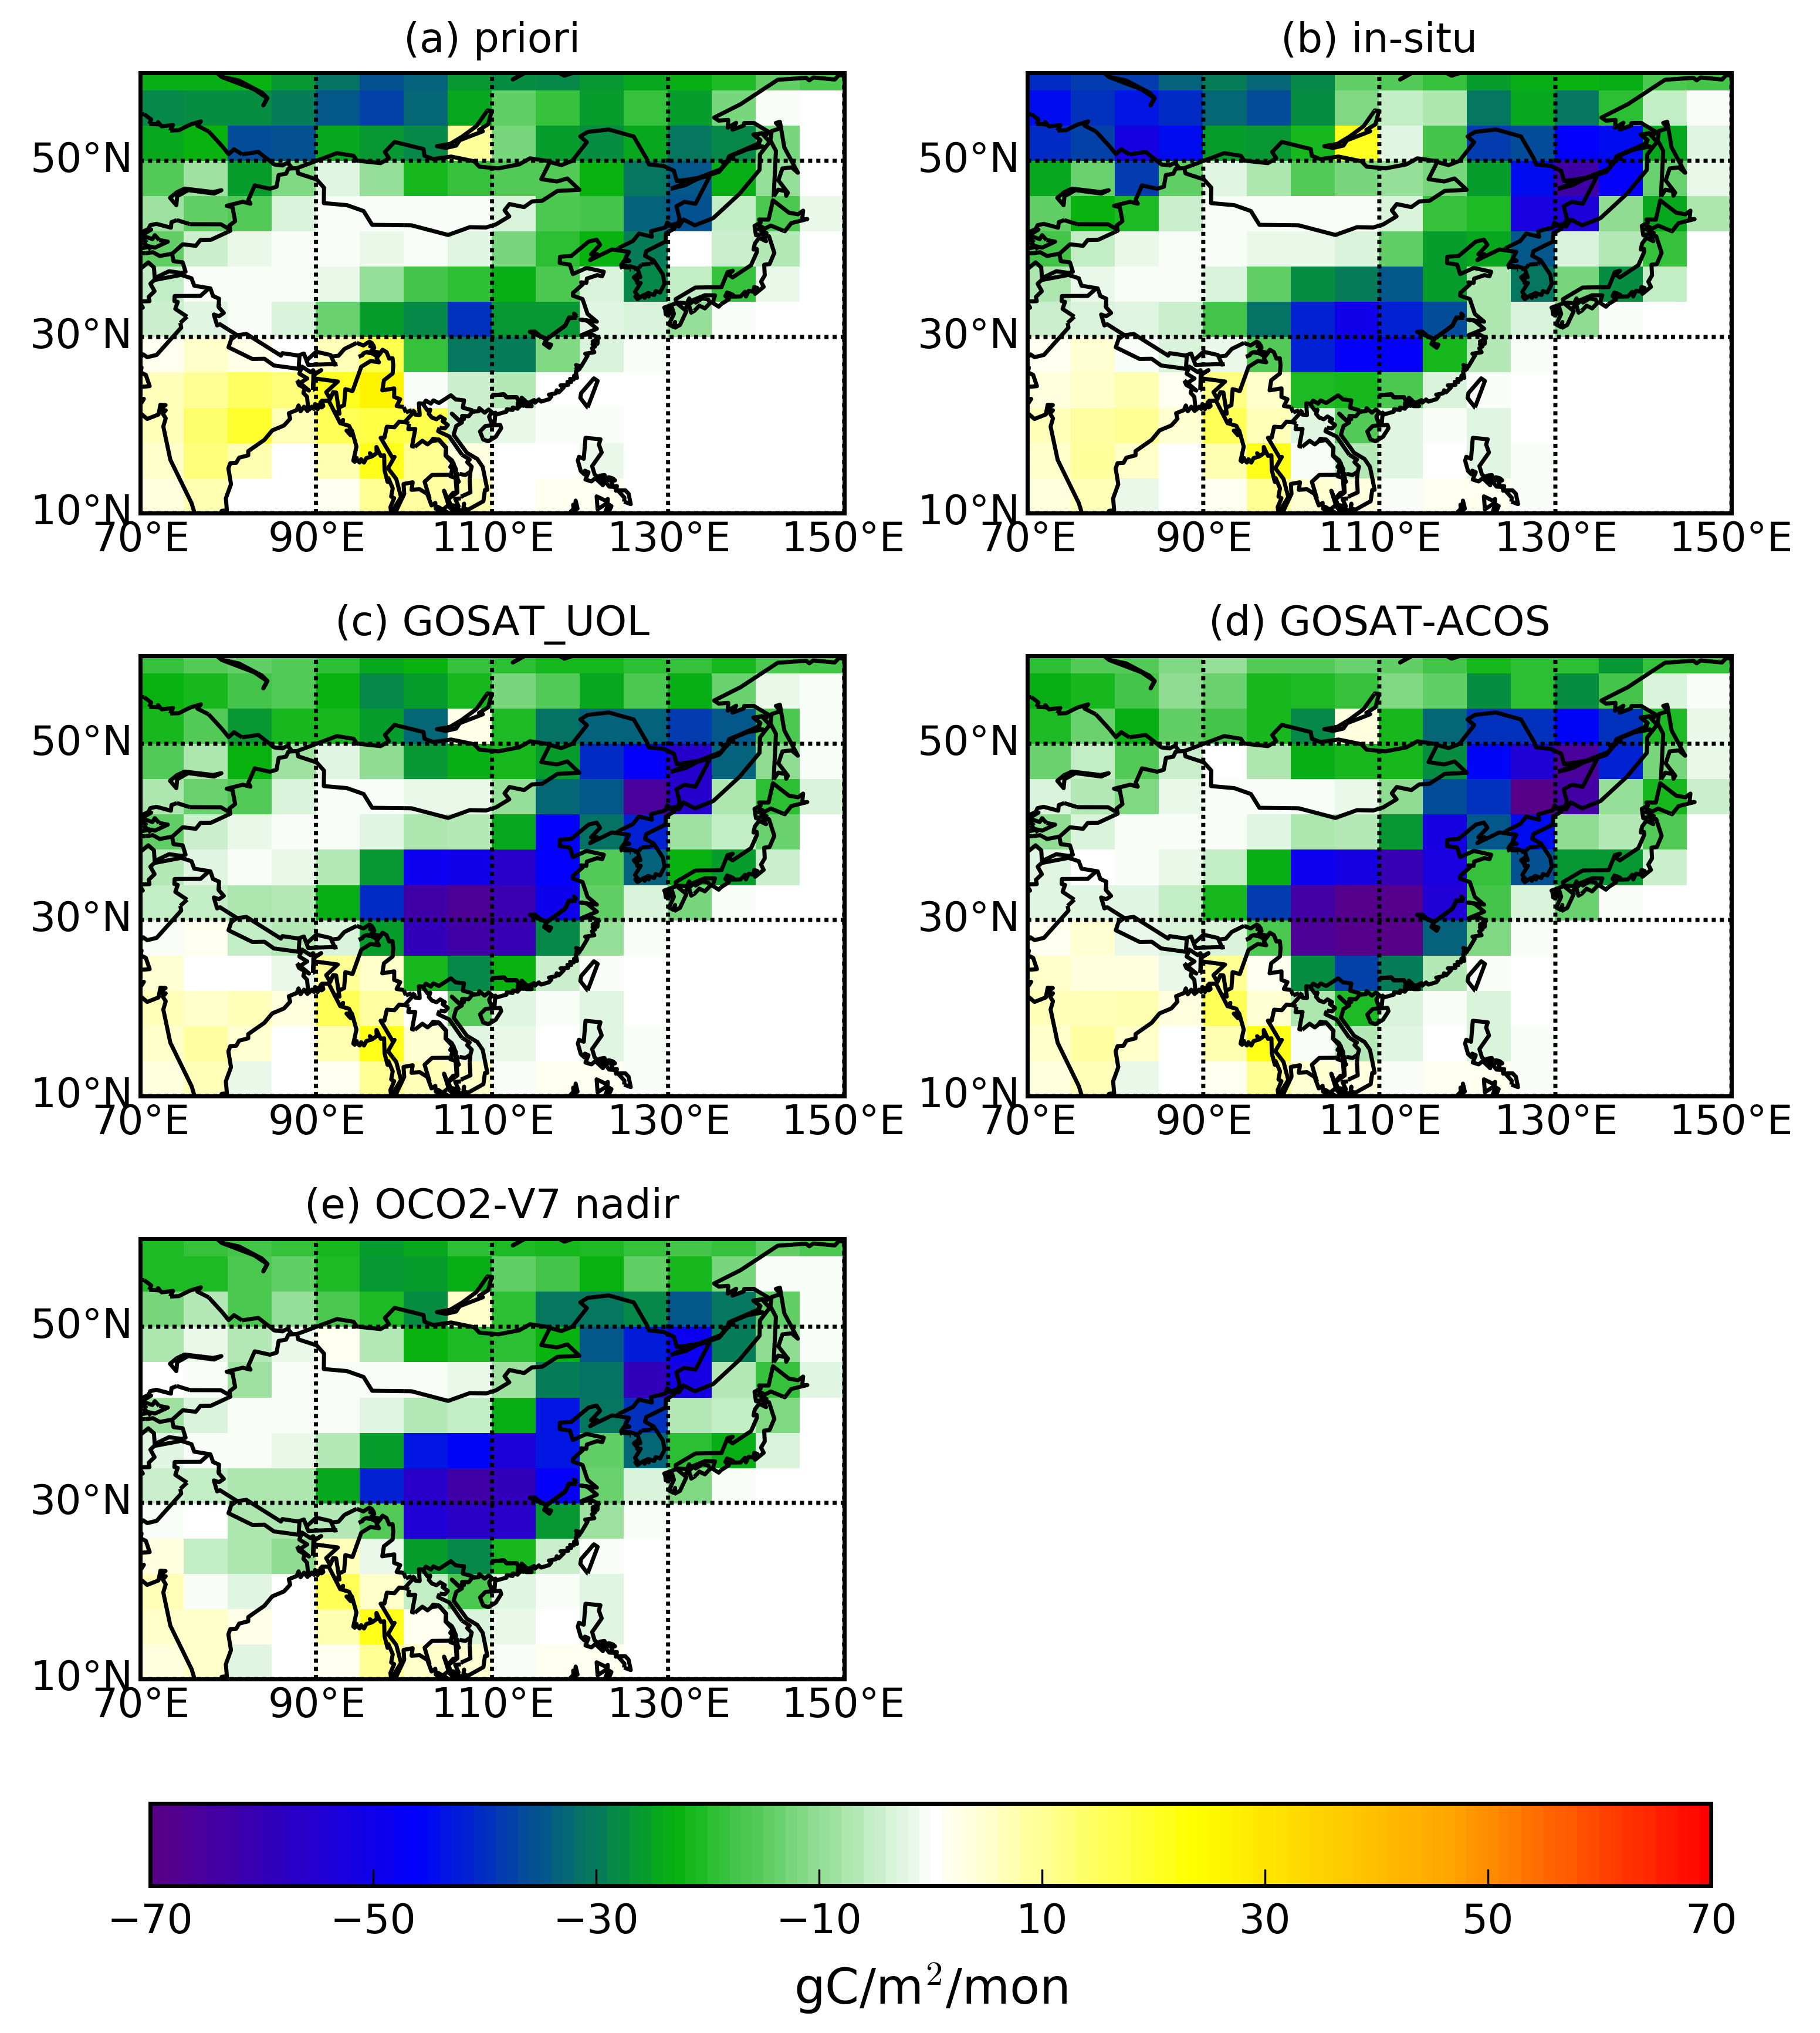
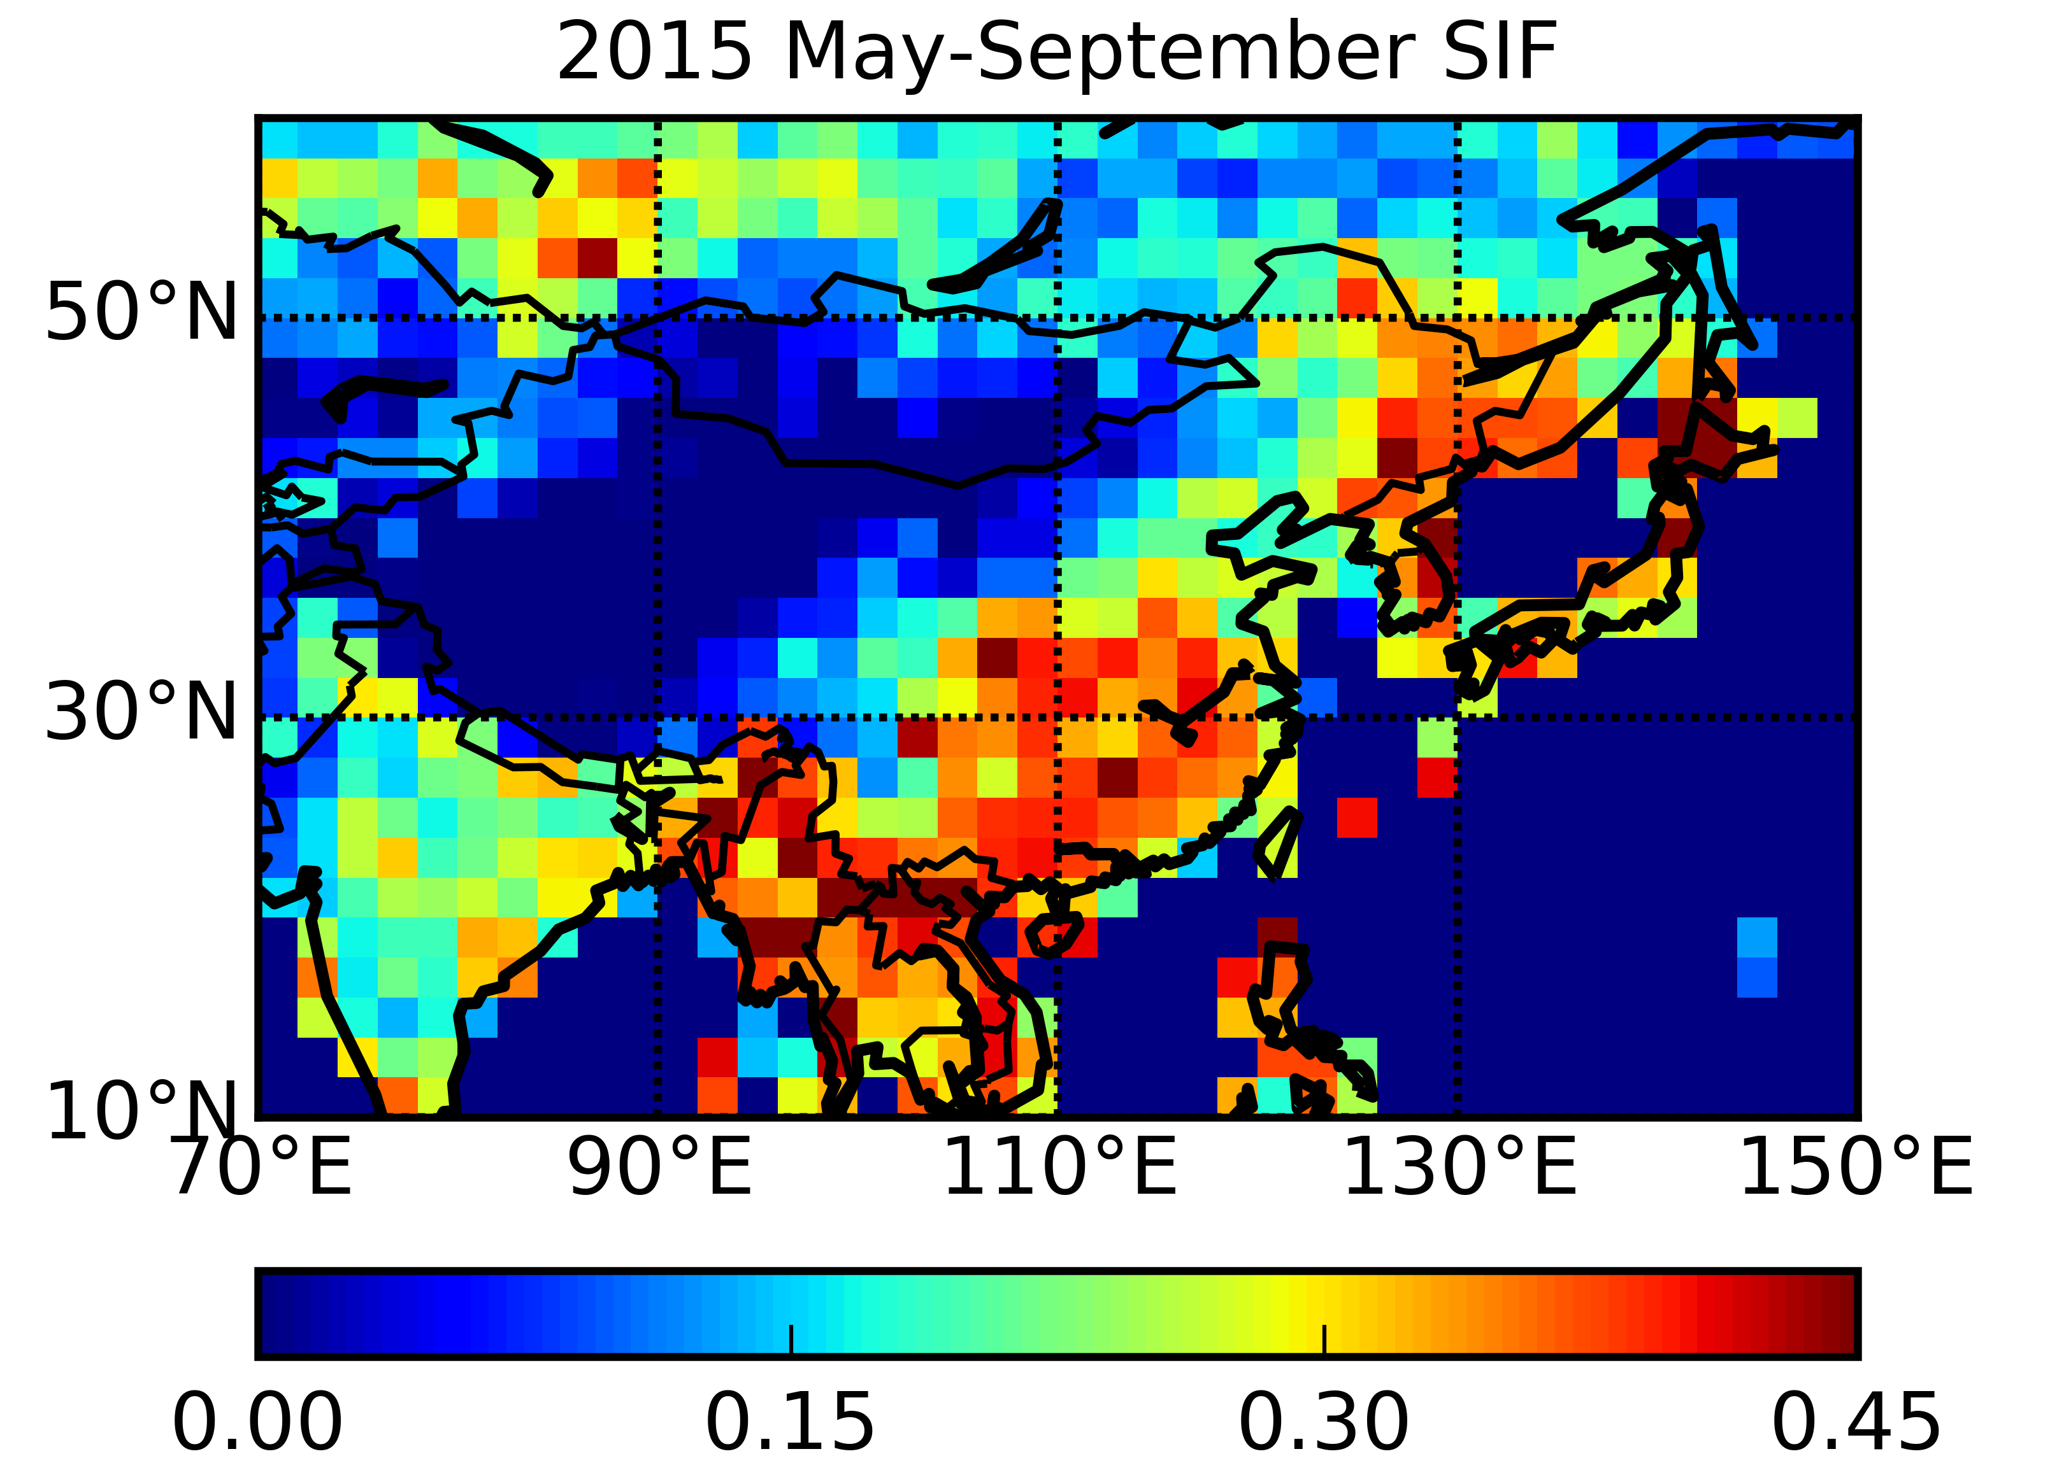
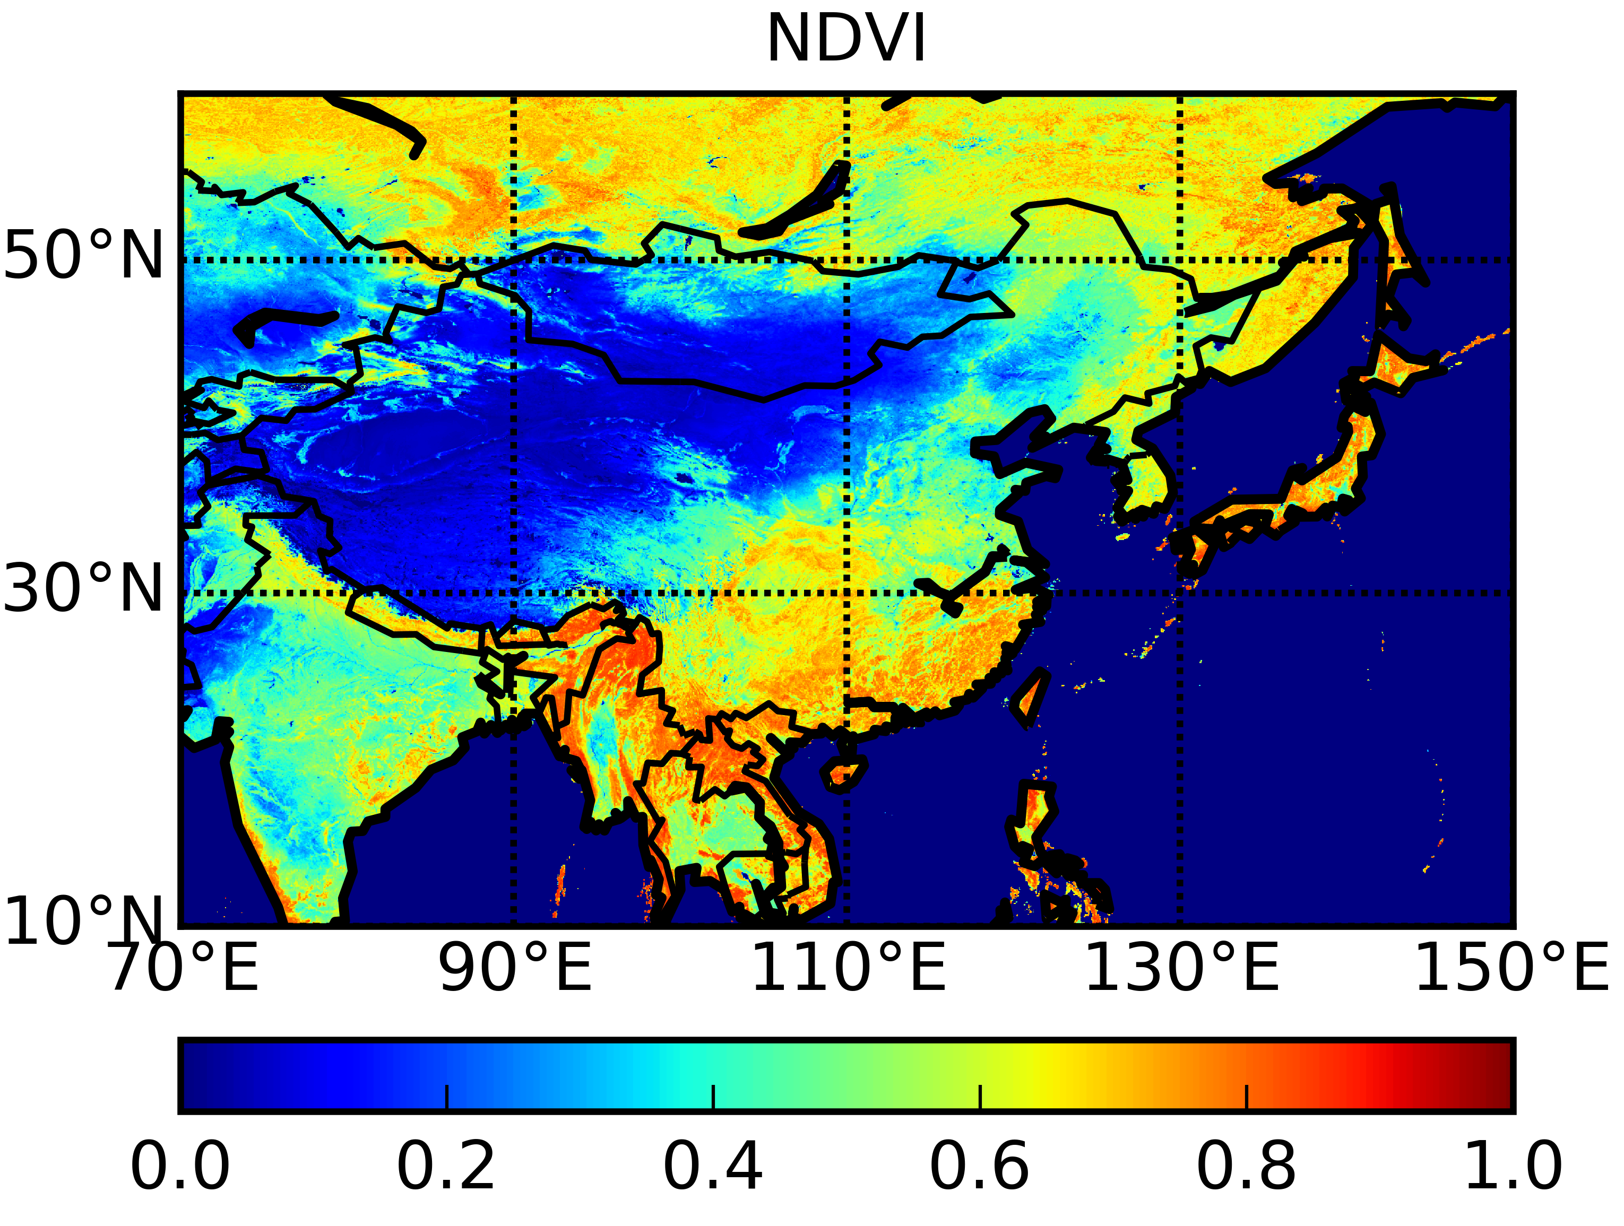
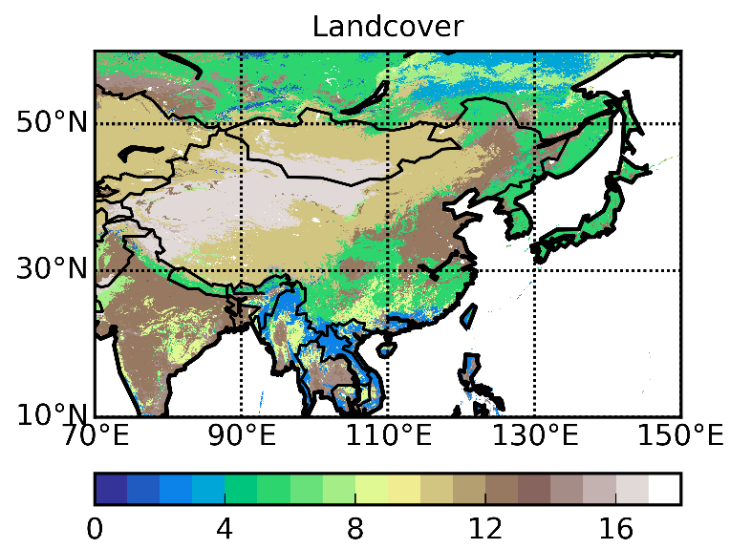
2015 May-September
OCO-2 SIF 755nm
Notes:
The uptake are mainly consistent with the forest distribution. But acos has larger uptake in the middle southern China. Because lack of available other in-situ istes to validate the results to say which is better.

Slide 9
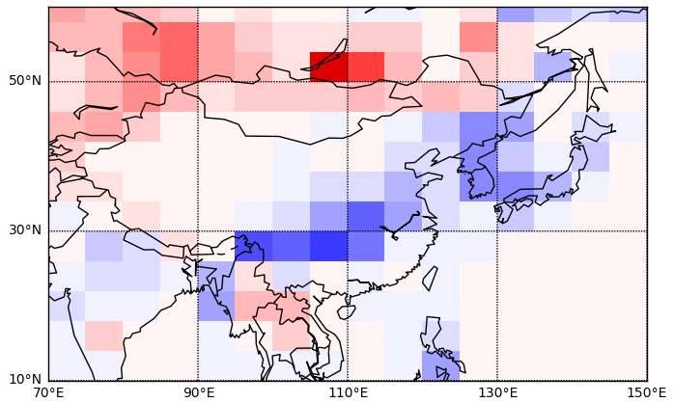
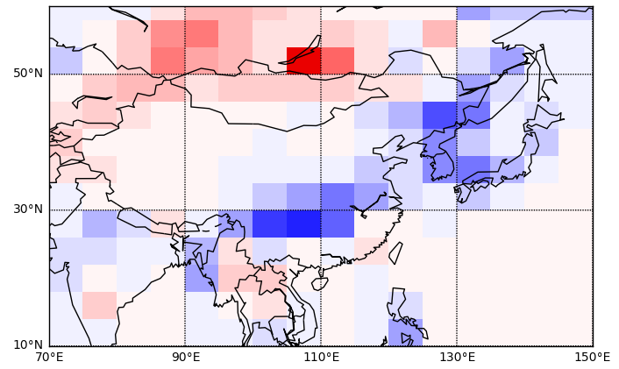
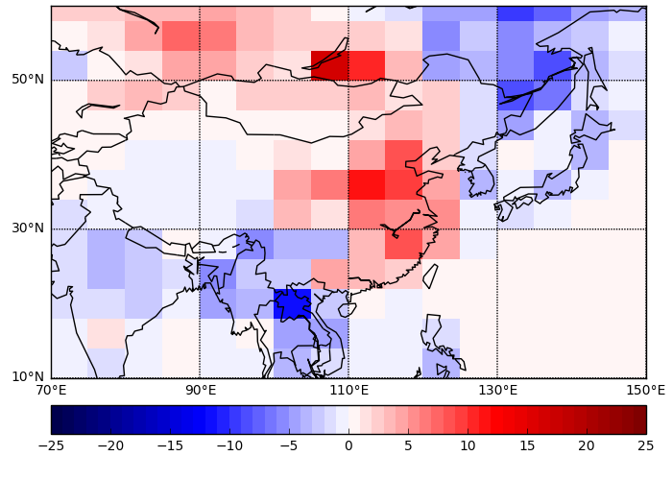
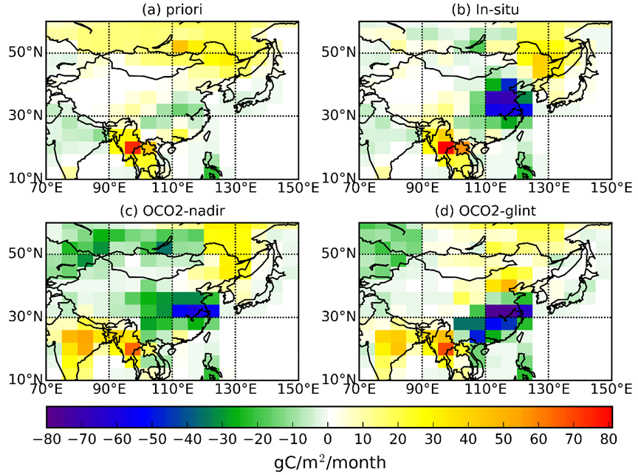
GOSAT UoL ano 2015
GOSAT ACOS ano 2015
In-Situ ano 2015
Anomalies of satellite results in 2015 are
more consistent with the vegetation
index variations
Notes:
This pictures are the anomalies of our posteriori flux. The

Slide 10
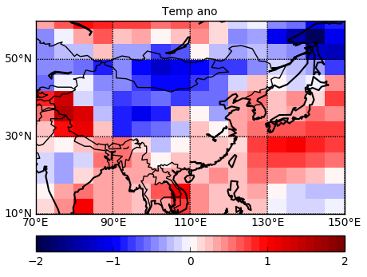
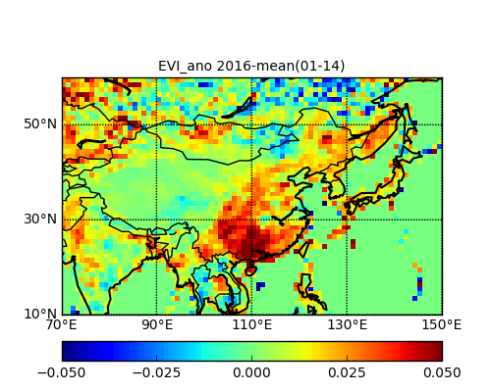
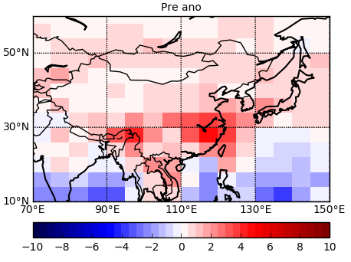

Slide 11
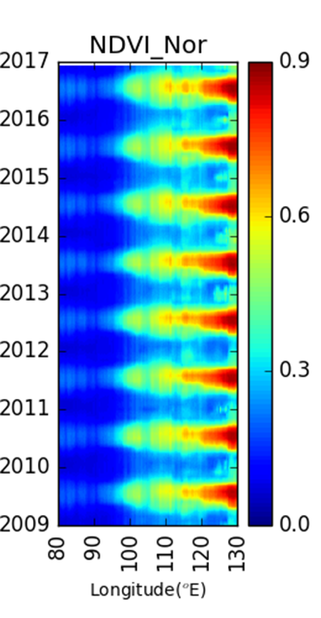
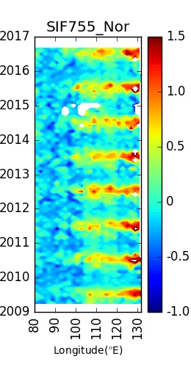
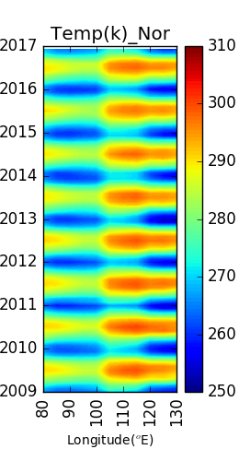
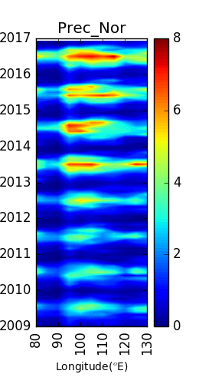
W/m2/sr/micron
mm/m2/day
In northern China, especially in northeast of China, with the increase of temperature and precipitation, the NDVI increased, not only the maximum in summer, but also the values in spring and autumn, which means more biosphere productivities in spring and autumn.
Notes:
Normalized Difference Vegetation Index (NDVI) and Enhanced Vegetation Index (EVI):
We devide China into northern part and southern part. The hovmoller gigures give the lonmean timeseries variations of pre,t,ndvi, and sif. We find that the significance increase of pre, and also increase of temperature. And lookat thd ndvi fig, in 2015 and 2016, the ndvi seems wider, this is caused by the NDVI increase in Autumn and Spring, and this will results in a higher annual mean NDVI and should be more uptake of biosphere.

Slide 12
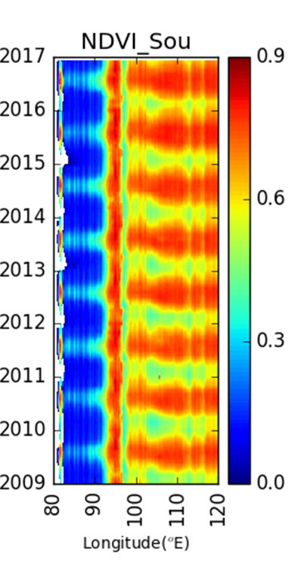
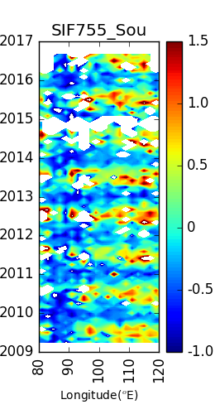
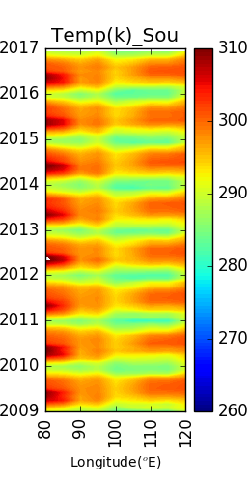
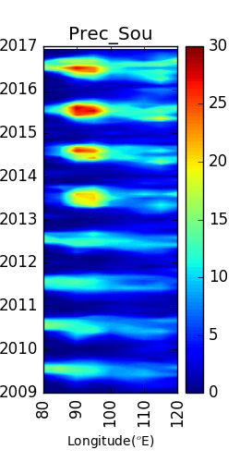
W/m2/sr/micron
mm/m2/day
Notes:
Similar with the northern part. But more significance ncrease of NDVI.

Slide 13
Findings:
The satellite inversions show larger seasonal amplitudes than the in-situ inversion.
During the growing season. Both satellite and in-situ inversions shows a spatial pattern consistent with the forest distributions
NDVI/EVI over northeast China increased in both 2015 and 2016, associated with higher temperature and an increase of precipitation. The change of NDVI and EVI in southern part is similar with the northern one, but maybe mainly due to the increased precipitations.
The flux anomalies from satellite inversions are more consistent with NDVI/EVI variations.

Slide 14
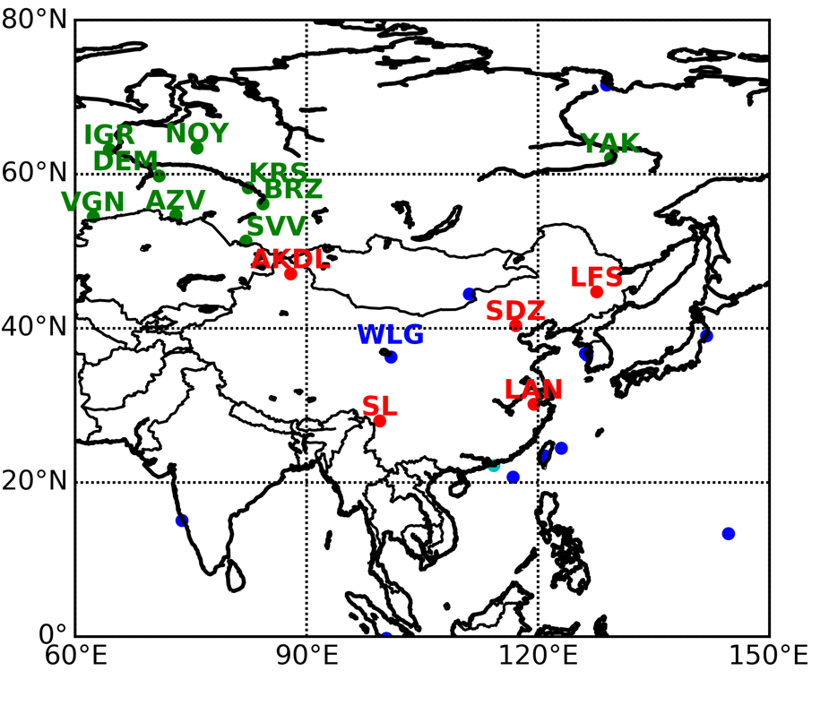
II. Large biosphere CO2 uptake over Southwest China.
NCEO-funded Collaboration with Chinese IAP and CMA enables us to get surface measurements over 5 extra sites (red)

Slide 15
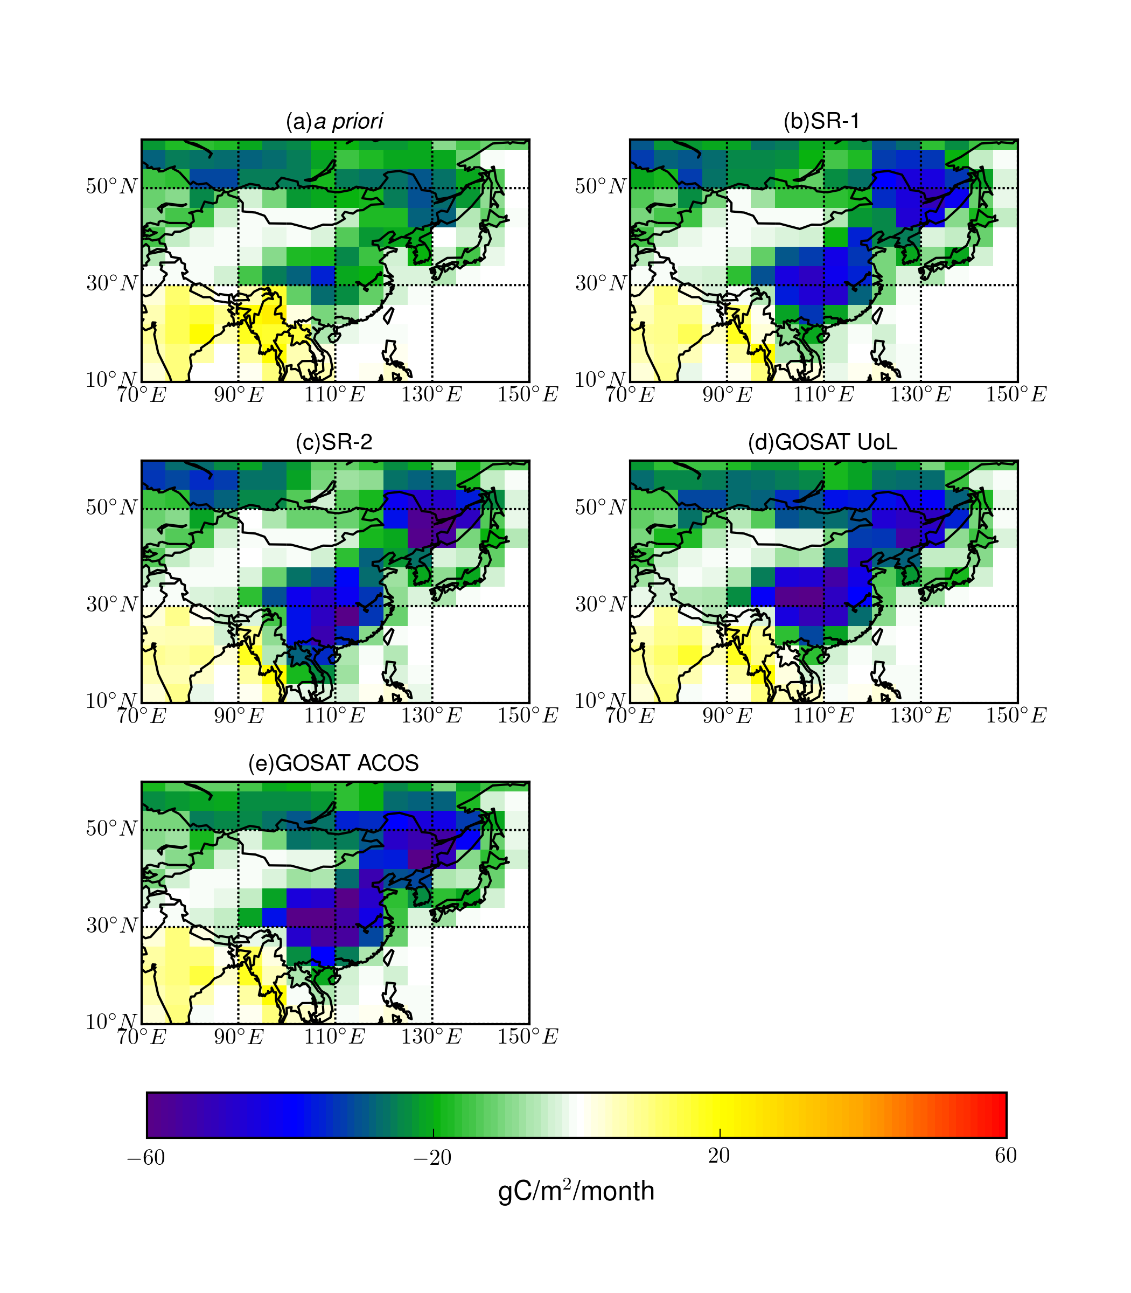

Extra observations result in more consistent flux pattern
NOAA site only
With extra sites
GOSAT (UoL)
Notes:
Sif直接相关于生态系统的光合作用和生产力，1. 直接表征植被光合作用强度；2. 用于证实植被光合作用和呼吸过程产生的碳通量

Slide 16
Now like GOSAT inversion, in-situ inversion also suggests
strong uptake over southwest China
NOAA
With CAM sites
Differences
Notes:
发现我国西南地区额外的碳汇
发现西伯利亚高纬地区为“碳源”，而非以往科学界普遍认为的“碳汇”

Slide 17
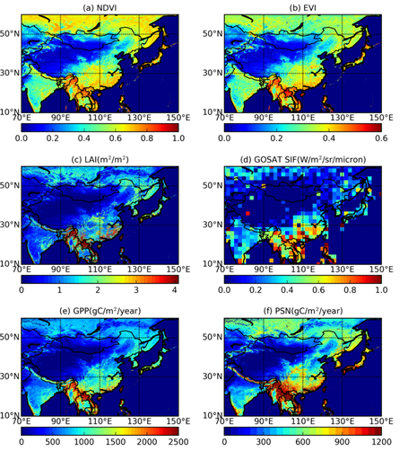
Strong uptake is consistent with corroborative satellite data

Slide 18
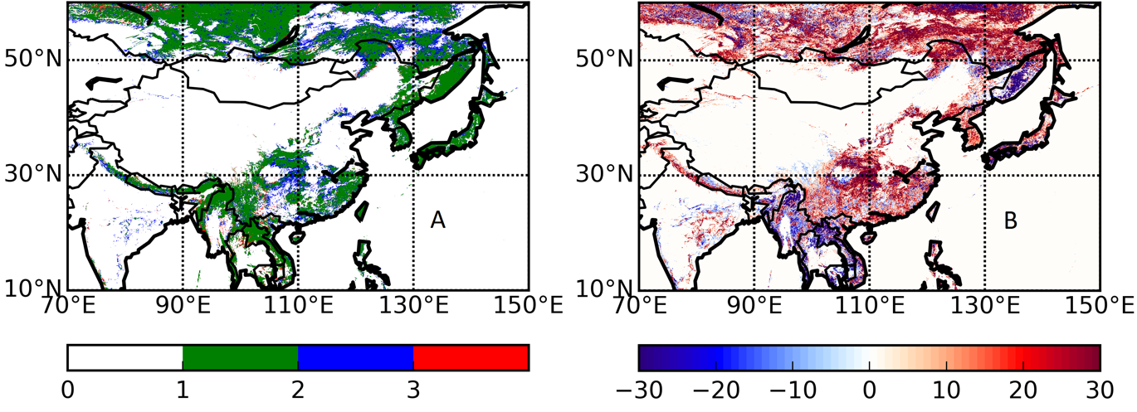
Increased forest coverage over Southwest China over 2002-2012
Land Cover type change
Coverage Change
Blue: Non-forest to forest
Red: Forest to Non-forest

Slide 19
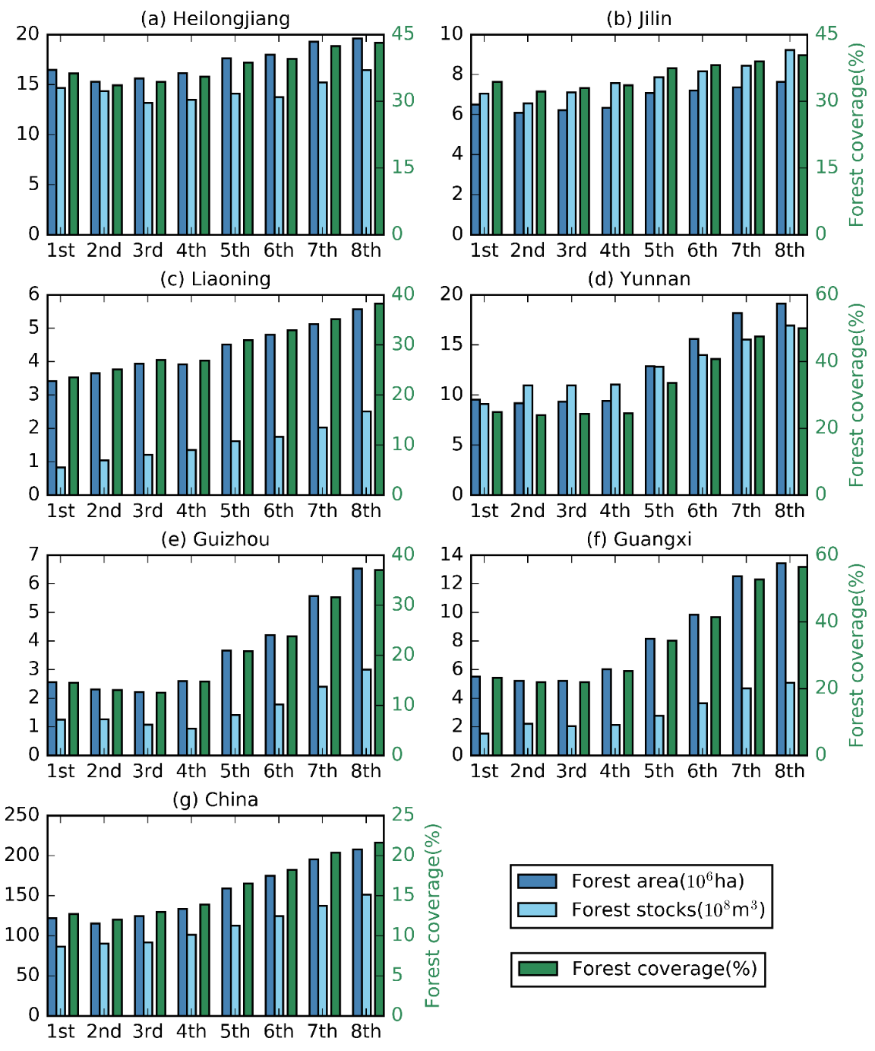
During 20 years (from 4st (1993) to 8th (2013) Forest survey), forest area of Southwest China has increased by nearly 80%.

Slide 20
Findings:
In-situ inversion with additional Chinese sites show strong uptake over southwest China, which is generally consistent with satellite inversions.
The strong uptake is also supported by corroborative space-based data as well as by ground survey.
Policy-driven afforestation in China help partially offset increase of anthropogenic emission.
Space-based GHG observations can be important part of validation network for national emission reduction.

Slide 21
Develop a framework for joint land and atmosphere data assimilation
Liang Feng, Paul Palmer, Jean-Francois Exbrayat, Mathew Williams + NCEO

Slide 22
III. Model framework for integrating atmosphere and land-surface carbon constraints
Current approach--surface fluxes as boundary conditions: Easy to implement, but Information not used to ‘improve’ biosphere model.
CTM
Atmosphere
ATMOS DATA
MODEL/DATA
Land
Ocean
LSM
LAND DATA
For most top-down inversion system, LSM has just been used to provide prior estimates, with no information on uncertainties

Slide 23
Future system: prognostic biosphere model will be part of the data assimilation system.
COUPLED MODEL
Atmosphere
ATMOS/LAND DATA
MODEL/DATA
Land
Ocean
Advantages: Simultaneously assimilate multiple observation data sets to optimize biosphere model.
Existing systems include CCDAS (EU); SPEEDY-VEGAS (US) etc.

Slide 24
Ensemble forecast
CTM
Atmospheric observations s
Driving data
EnKF
Atmosphere analysis
Land observations
LAI/SIF/
Biosphere
model
Optimized parameters
Challenges:
Ill-conditioned ; under-constrained, nonlinear, computationally expensive for CTM
We simplify the process by using Quasi-sequential data assimilation approach.

Slide 25
Ensemble forecast
CTM
Atmospheric observations s
Driving data
EnKF
Atmosphere analysis
Some Land data (e.g., SIF)
Simplified Biosphere
model
Full Biosphere model
Optimized parameters
(Most) Land observations
Off-line full biosphere model data assimilation
Construct depends of NEE on only essential land parameters
Assimilation centration data

Slide 26
Currently,
off-line biospheric model: CARDMOM
Simplified model: Simplified DALEC
We plan to design the system to be flexible, and easy to use other models.

Slide 27
GPP = f(LAI, T, C_{eff})
Ra = F_{Ra}×GPP
C_{veg}
Rh = k_{soil}×C_{soil}×f_{T}
k_{veg}×C_{veg}×f_{T}
C_{soil}
f_{T} = exp(t_{fac}×T)
NEE = GPP-Ra-Rh
Notes:
simplified DALEC model of the terrestrial carbon cycle
Arrows indicate fluxes, boxes indicate pools.
GPP is simulated using the ACM emulator of the SPA model as a function of LAI, air temperature (T) and a canopy efficiency parameter (Ceff). Ra is a fixed fraction of GPP. Cveg and Csoil turnover follow first order kinetics, with reference turnover rates kveg and ksoil adjusted as an exponential function of air temperature.
NEE is simulated as the difference between GPP and the respiration fluxes Ra and Rh.
At the moment, the plan is to prescribed LAI using satellite observations, and use GFED4 emissions to close the carbon balance.
A total of 5 process parameters (in red) and two initial conditions can be derived from offline CARDAMOM simulations.
source code available from https://github.com/jfexbrayat/simple_carbon

Slide 28
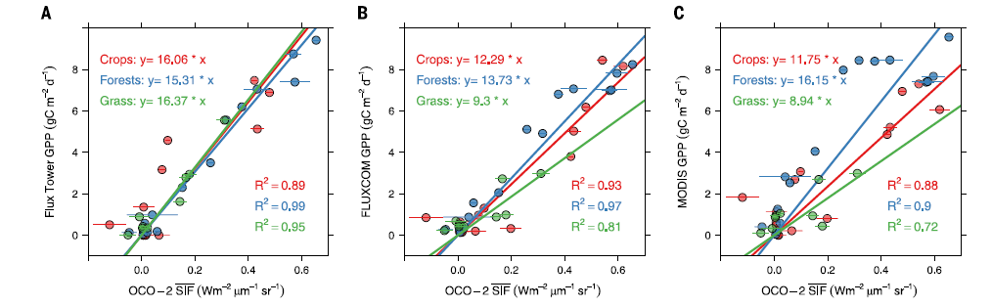
We are exploring many potential questions:
Whether we need to Introduce correlation to further reduce number of variables.
How and where we should model relation between SIF and GPP.
Which are the best test regions.
Sun et al, Science 2017.
Feedbacks to CARDAMOM (?)

Slide 29
Milestones for 2.5 years
Implement and test the prototype framework based on simplified model.
Experimentally assimilate long-term observation data set.
5-year target.
Assimilate multiple data streams into the coupled system.

